Slide 1


An Empirical Study of Rust-for-Linux: The Success, Dissatisfaction, and Compromise
^{(*)}Hongyu Li¹, ^{(*)}Liwei Guo², Yexuan Yang¹, Shangguang Wang¹, Mengwei Xu¹
(*) = co-primary
¹Beijing University of Posts and
Telecommunications
²University of Electronic Science and Technology of China

Slide 2




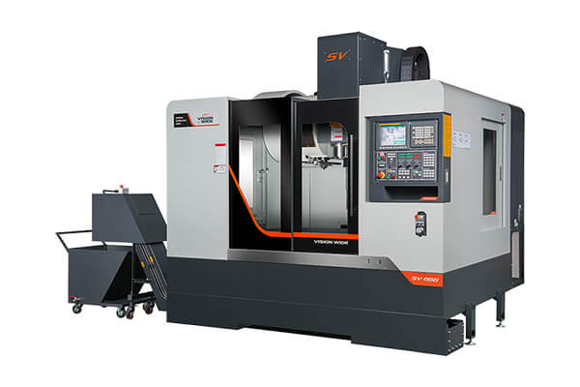

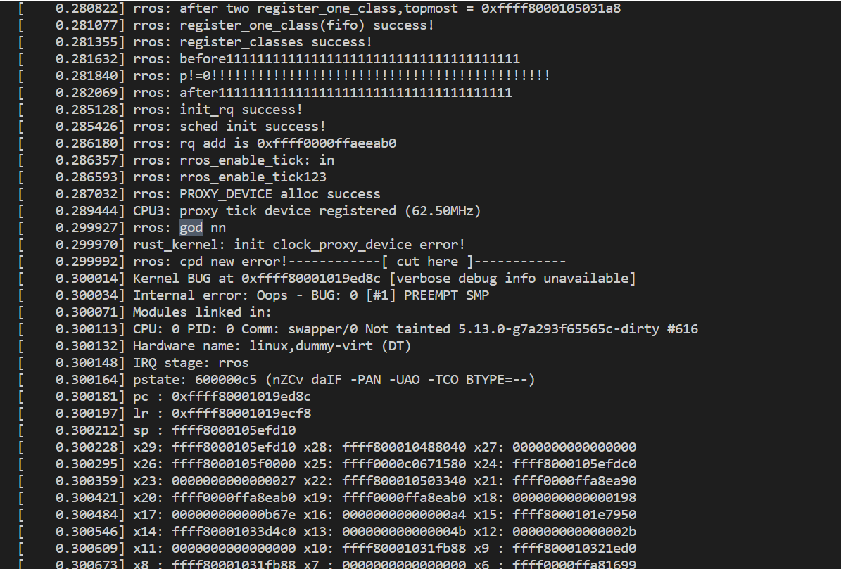
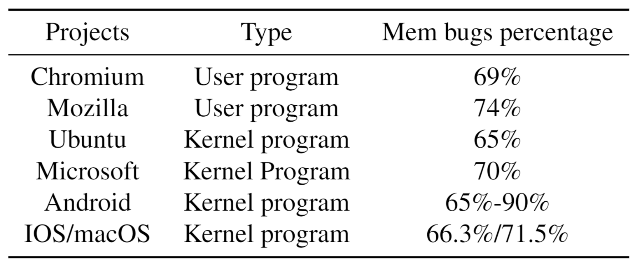
Linux suffers from bugs
Software based on Linux

Slide 3
Efforts to counter Memory/Thread bugs
Static analysis^{[1]}
Gcc –Wanalyze*
Clang
cppcheck
Codechecker
Runtime detection^{[2]}
Kernel Memory Sanitizer (KMSAN)
Kernel Concurrency Sanitizer (KCSAN)
Undefined Behavior Sanitizer (UBSAN)
Kernel testing^{[2]}
KUnit/Kselftest/LTP/Kernel CI/Fuzz
Take that!
Linux Community
Bring it on!
Memory/Thread Bugs
[1] https://events.linuxfoundation.org/wp-content/uploads/2021/01/Static-Analysis-JSMoeller-LF-Live-Mentor-Series.pdf
[2] https://www.kernel.org/doc/html/next/dev-tools/index.html

Slide 4
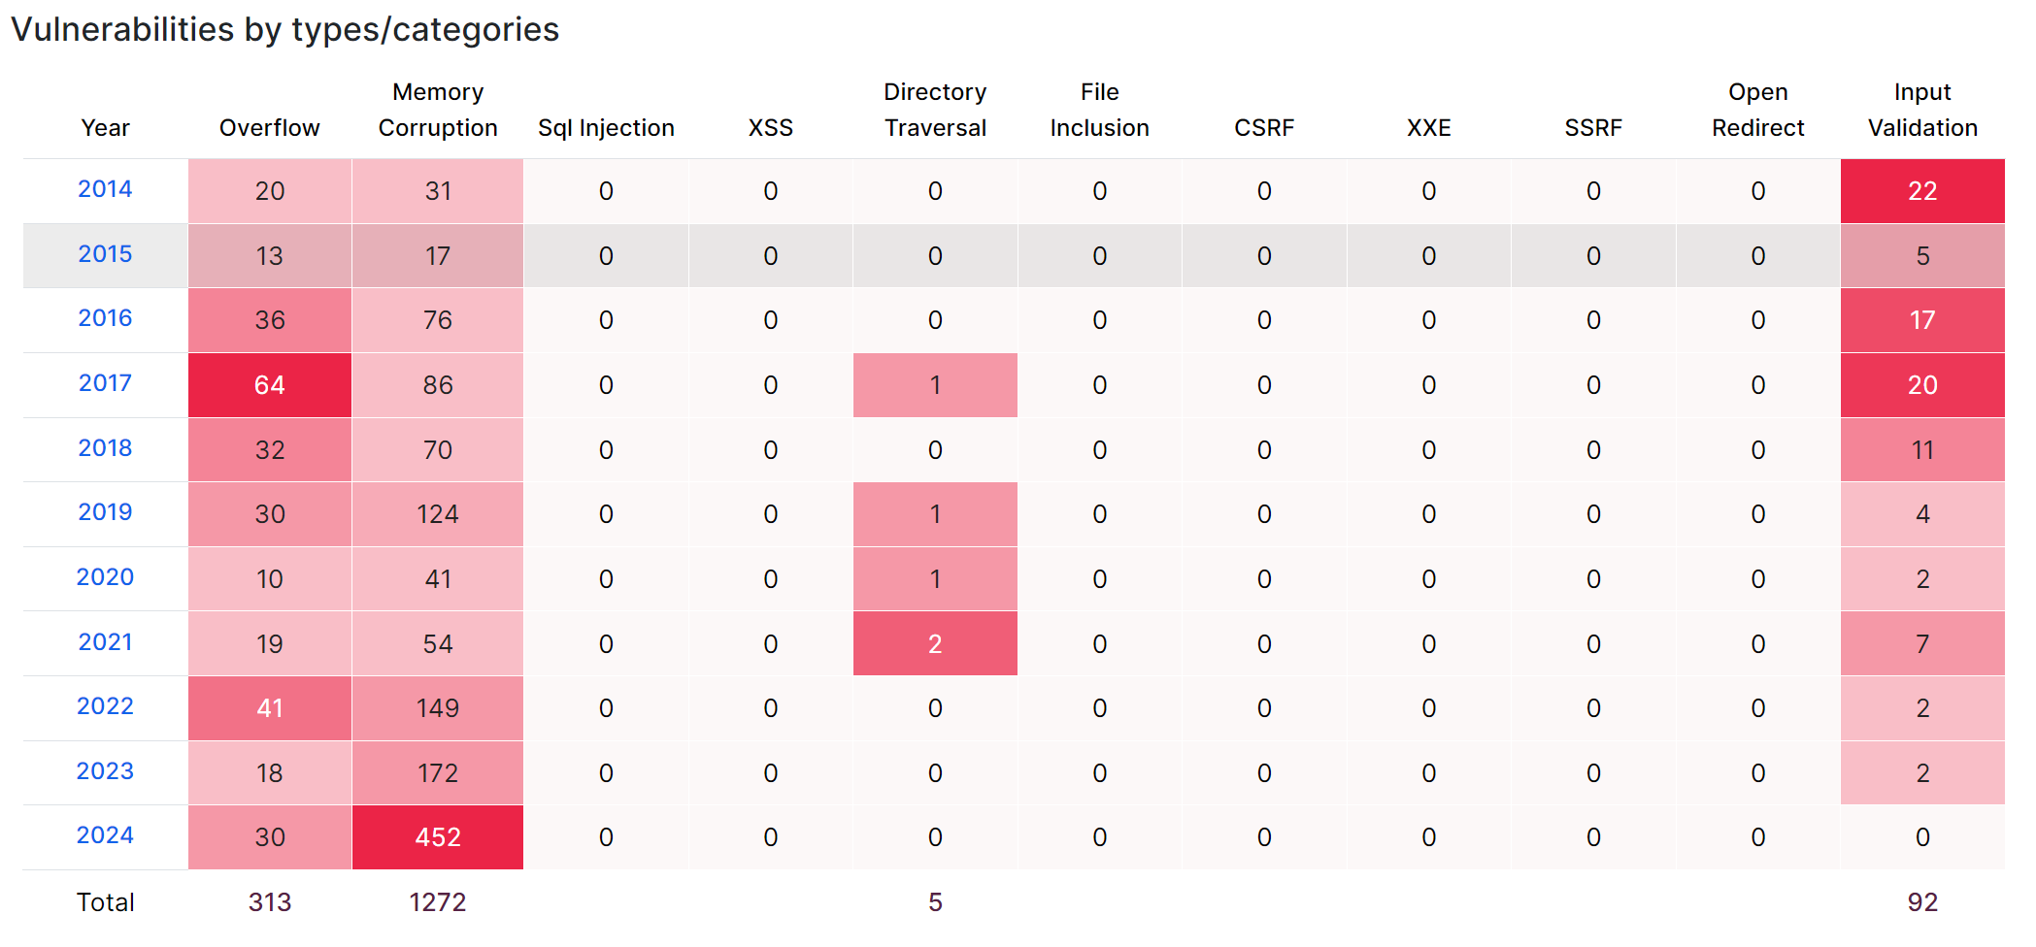
But Memory/Thread bugs still exist^{[1]}
I‘m still here!
Memory/Thread Bugs
[1] https://www.cvedetails.com/product/47/Linux-Linux-Kernel.html?vendor_id=33

Slide 5
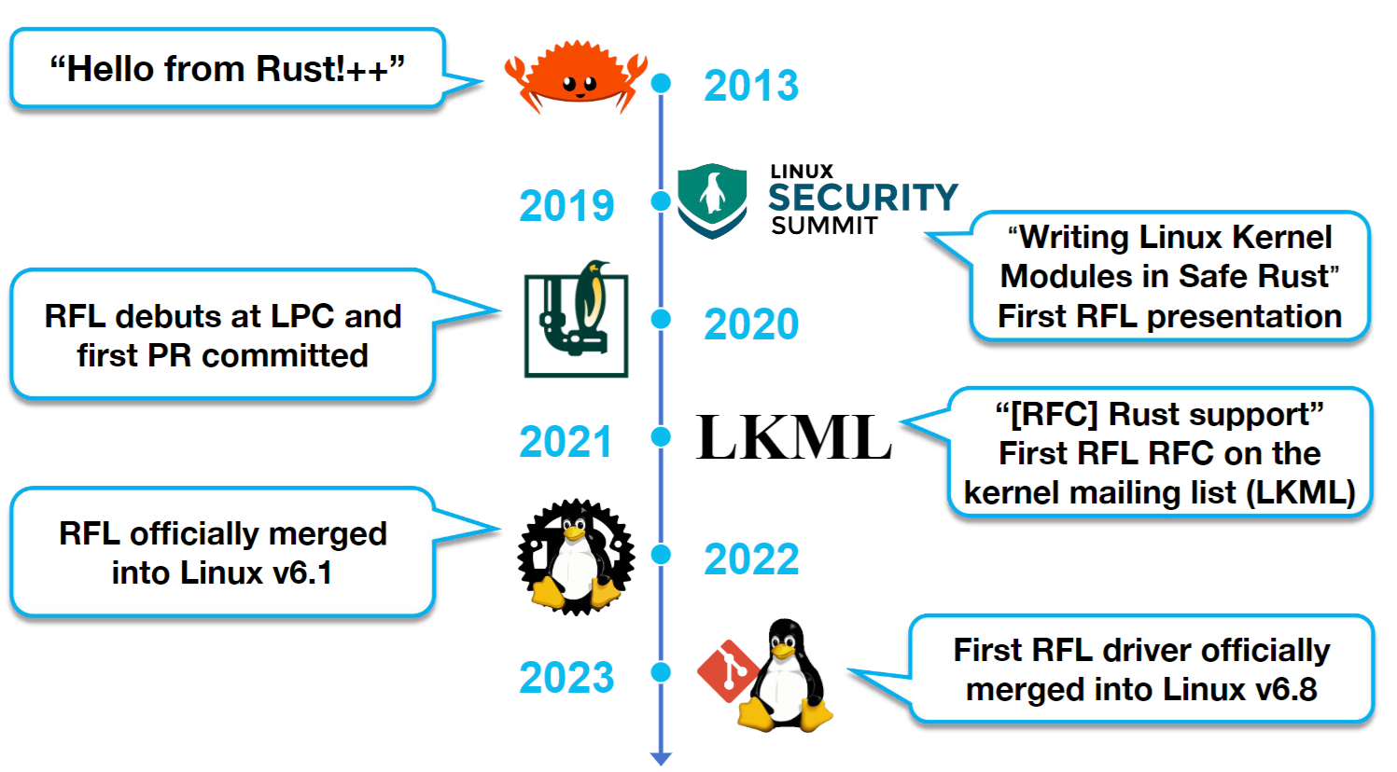


Rust can help
I have Rust!
Rust-for-Linux
Rust-for-Linux (RFL) wants to write drivers with Rust
Before meeting Rust:
“I have yet to see a language that comes even close to C.”
After meeting Rust:
“While I won’t make any promises, I’d like to see Rust merging into the Linux kernel with the next release.”

Slide 6
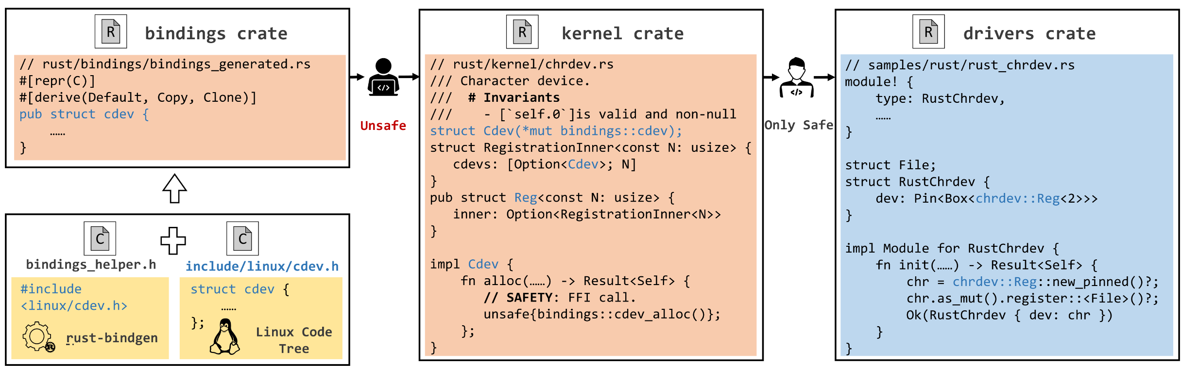
Background
1. Rust’s safety rules cause limited expressiveness (Double linked list)
2. Code in the Unsafe block can break the safety rules
Calling function from foreign function interface (FFI) needs unsafe blocks
3. It’s proven possible to wrap unsafe blocks under safe APIs

Slide 7
Motivation
While we know about Rust, RFL is rarely studied
RQ1: what is the status quo of RFL?
RQ2: does RFL live up to the hype?
RQ3: what are the lessons learned from RFL?
Memory/Thread Bugs
Rust-for-Linux

Slide 8
RQ1: what is the status quo of RFL?
Q1: RFL development status
Q2: How to construct safety abstraction
Q3: How to rustify device drivers

Slide 9
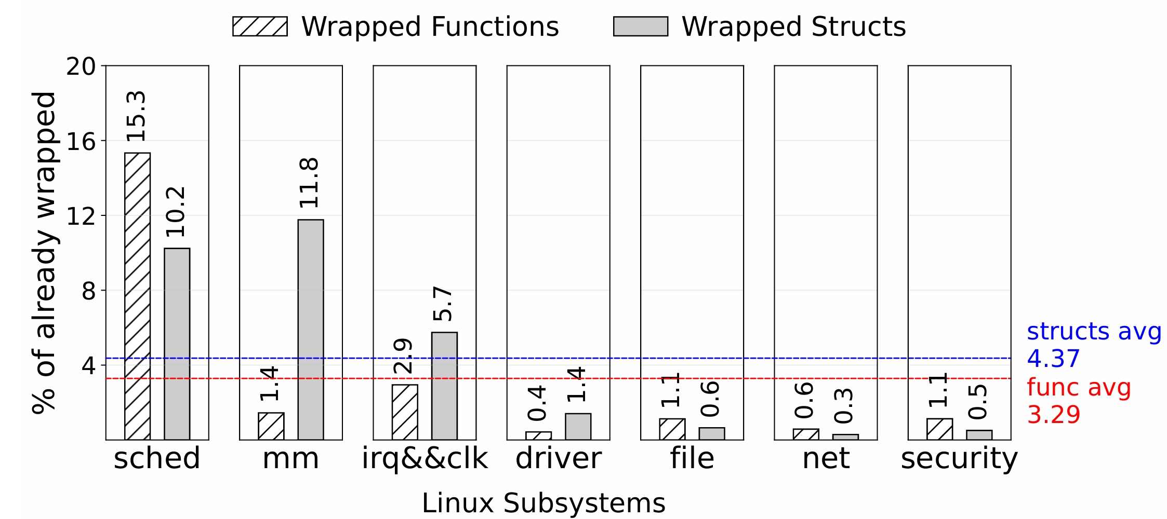
Q1: RFL development status (RQ1)
Development progress
Insight 1: drivers, netdev, and file systems are the long tail of RFL code.

Slide 10
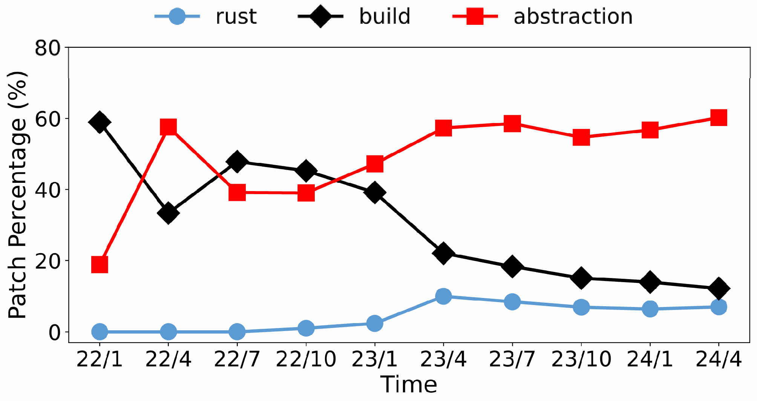
Q1: RFL development status (RQ1)
Development progress
Patch distribution
Insight 2: RFL infrastructure has matured, with safe abstraction and drivers being the next focus.

Slide 11
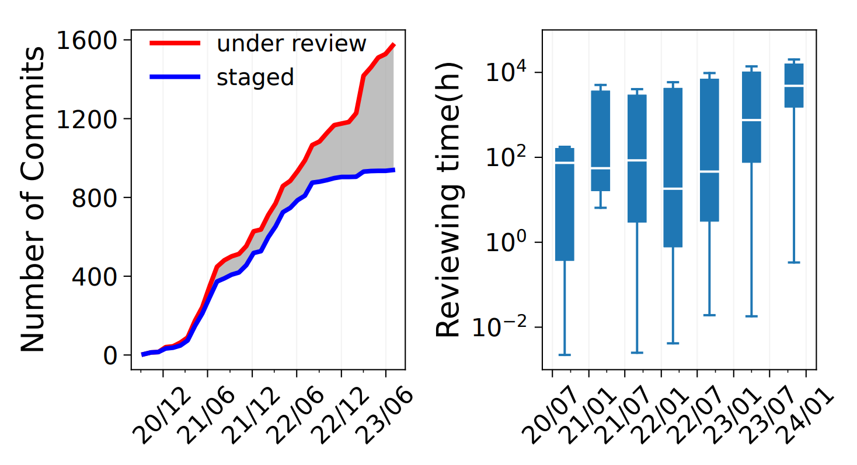
Q1: RFL development status (RQ1)
Development progress
Patch distribution
The trend
Insight 3: RFL is bottlenecked by code review but not by code development.

Slide 12
Q2: How to construct safety abstraction (RQ1)
Structs safety abstraction
rust-bindgen: same layout in memory
struct llist_head {
struct llist_node *first;
};
#[repr(C)]
#[derive(Copy, Clone)]
pub struct llist_head {
pub first: *mut llist_node,
}
impl Default for llist_head {
fn default() -> Self {
unsafe { ::core::mem::zeroed() }
}
}

Slide 13
Q2: How to construct safety abstraction (RQ1)
Structs safety abstraction
rust-bindgen: same layout in memory
Bit field/union
struct fs_parameter {
const char *key; /* Parameter name */
enum fs_value_type type:8; /* The type of value here */
union {
char *string;
void *blob;
struct filename *name;
struct file *file;
};
};

Slide 14
Q2: How to construct safety abstraction (RQ1)
Structs safety abstraction
rust-bindgen: same layout in memory
Bit field/union
pub struct __BindgenBitfieldUnit<Storage, Align> {
storage: Storage,
align: [Align; 0],
}
impl<Storage, Align> __BindgenBitfieldUnit<Storage, Align> {
pub fn get(&self, bit_offset: usize, bit_width: u8) -> u64
pub fn set(&mut self, bit_offset: usize, bit_width: u8, val: u64)
}

Slide 15
Q2: How to construct safety abstraction (RQ1)
Structs safety abstraction
rust-bindgen: same layout in memory
Abstraction
Deref is valid: *ptr -> foo<*mut ptr>
impl File {
/// Creates a reference to a [`File`] from a valid pointer.
/// # Safety
/// The caller must ensure that `ptr` is valid and remains valid for the lifetime of
/// the returned [`File`] instance.
pub(crate) unsafe fn from_ptr<'a>(ptr: *const bindings::file) -> &'a File {
// SAFETY: The safety requirements guarantee the validity of the dereference,
// while the `File` type being transparent makes the cast ok.
unsafe { &*ptr.cast() }
}
}

Slide 16
Q2: How to construct safety abstraction (RQ1)
Structs safety abstraction
Functions safety abstraction
Functions as the members of the struct
/// # Invariants
/// # Safety
// SAFETY:
impl File {
/// Returns the flags associated with the file.
///
/// The flags are a combination of the constants in [`flags`].
pub fn flags(&self) -> u32 {
// SAFETY: The file is valid because the shared reference guarantees a nonzero refcount.
unsafe { core::ptr::addr_of!((*self.0.get()).f_flags).read() }
}}

Slide 17
Q2: How to construct safety abstraction (RQ1)
Structs safety abstraction
Functions safety abstraction
Functions as the members of the struct
Function pointers as trait
impl<T: Operations> OpsTable<T> {
const VTABLE: bindings::dev_pm_ops = bindings::dev_pm_ops {
suspend: Some(suspend_callback::<T>),
resume: Some(resume_callback::<T>),
freeze: Some(freeze_callback::<T>),
restore: Some(restore_callback::<T>),
}; ……
}

Slide 18
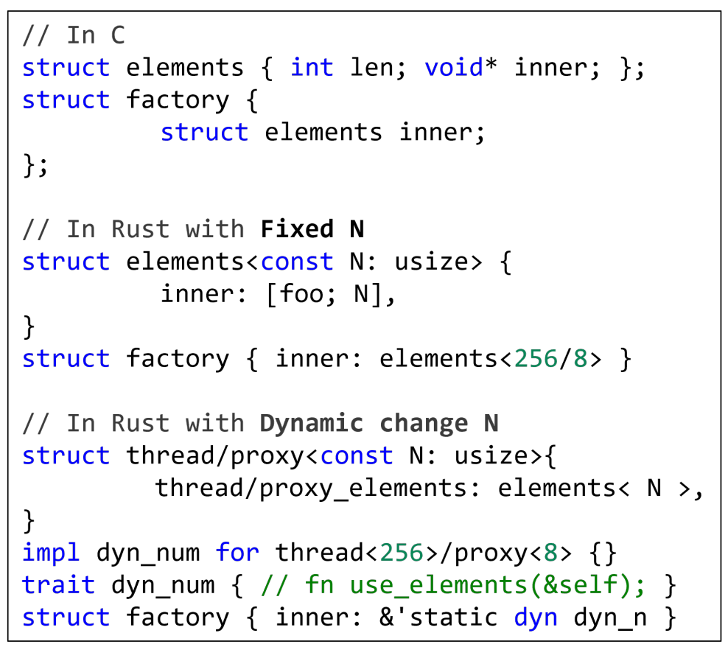
Q3: How to rustify device drivers (RQ1)
Workflow
Device probe
Driver logic
Device cleanup
Rust/RFL abstraction influences programing inflexibility

Slide 19
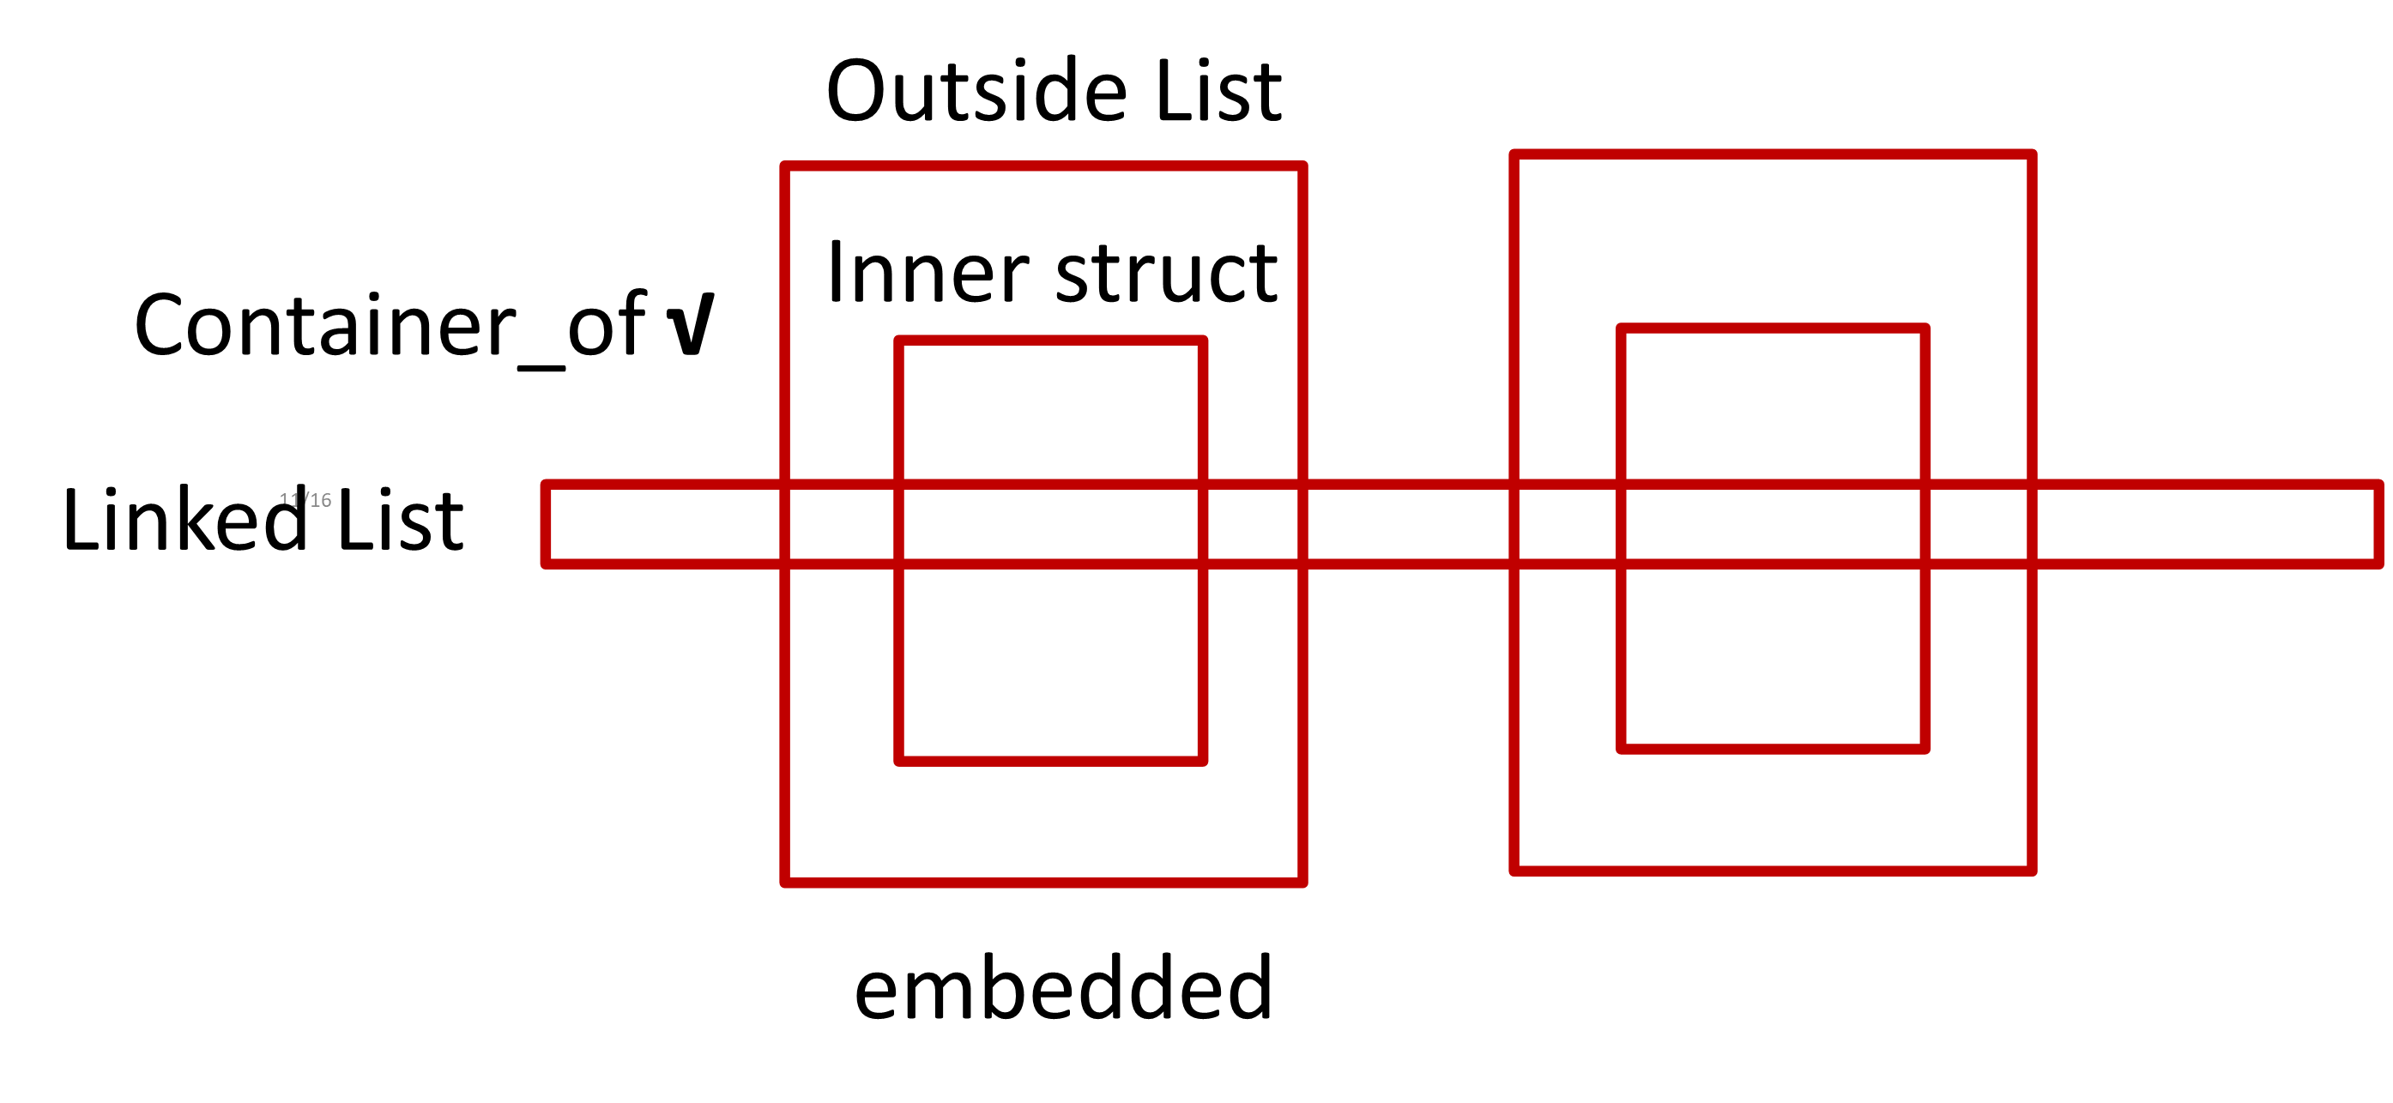
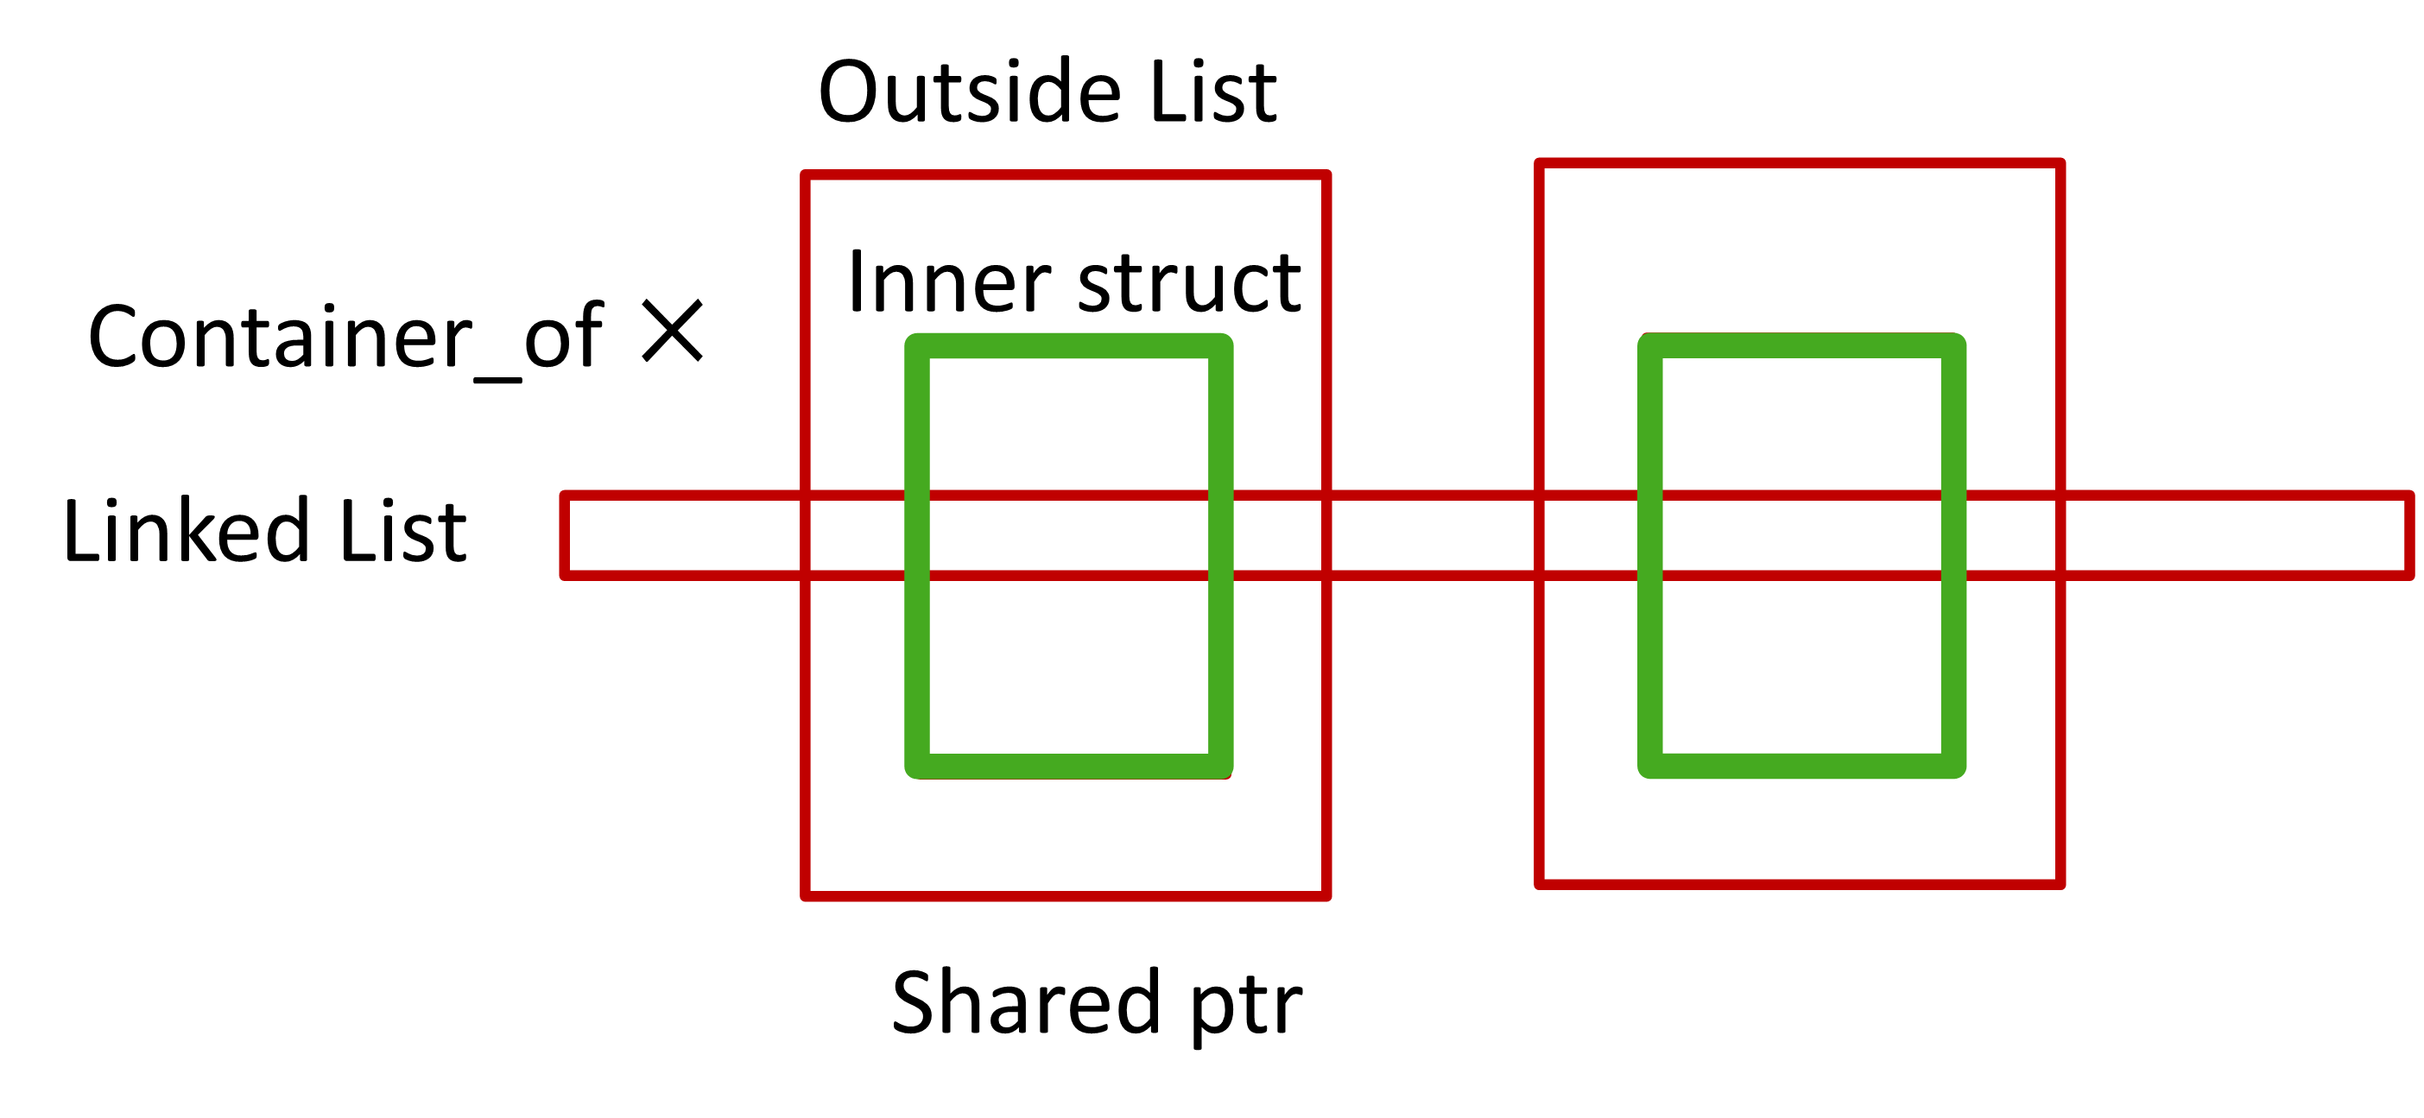
Q3: How to rustify device drivers (RQ1)
Workflow
Rust/RFL abstraction influences programing flexibility
Container_of
Insight 4: The major difficulty of writing safe drivers in Rust is to reconcile the inflexibility of Rust versus kernel programming conventions.

Slide 20
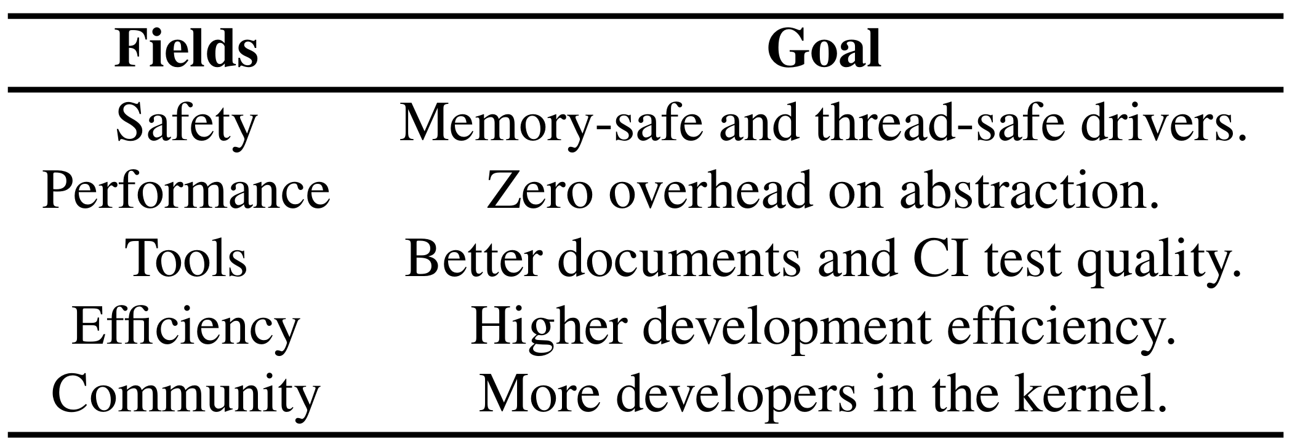
RQ2: does RFL live up to the hype?
Q1: Does Rust help Linux become safer?
Q2: Does Rust bring additional overhead?
Q3: How does Rust improve Linux development?

Slide 21
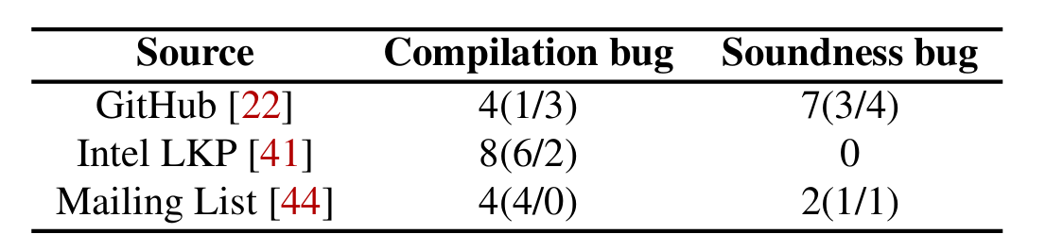
Q1: Does Rust help Linux become safer? (RQ2)
There exist soundness bugs in the safety abstractions
Wrapping unsafe APIs needs manually review
Bugs may not disappear, just hide deeper^{[1]}
[1] https://lwn.net/Articles/953116/

Slide 22
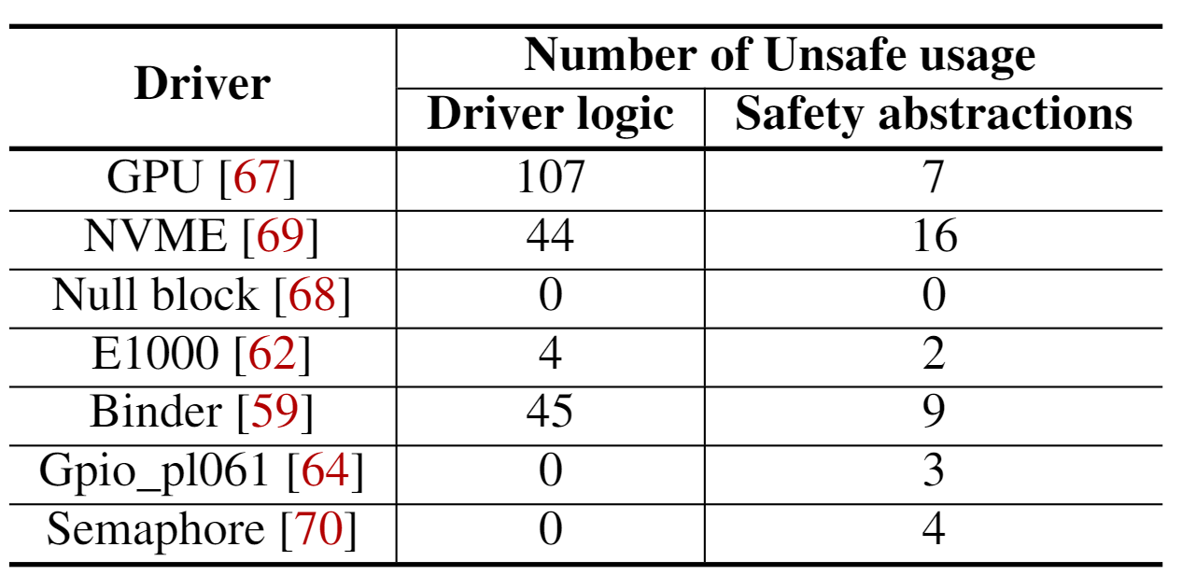
Q1: Does Rust help Linux become safer? (RQ2)
There exist soundness bugs in the safety abstractions
The RFL drivers use unsafe blocks
The driver itself still needs unsafe due to complex logic
The safety abstraction is hard to maintain pure safe^{[1]}
Insight 5: with RFL, Linux becomes more “securable” but still cannot be fully secure.
[1] https://github.com/Rust-for-Linux/linux/commit/90e53c5e70a69159ec255fec361f7dcf9cf36eae

Slide 23
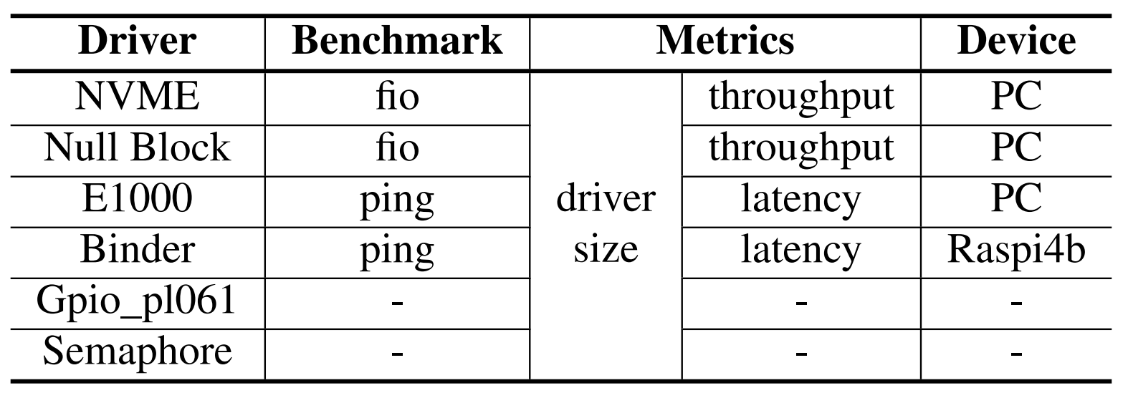
Q2: Does Rust bring additional overhead? (RQ2)
Setup
NVME and binder are considered the first batch of drivers to be merged in the Linux mainline
Others: File system/Network/Driver

Slide 24
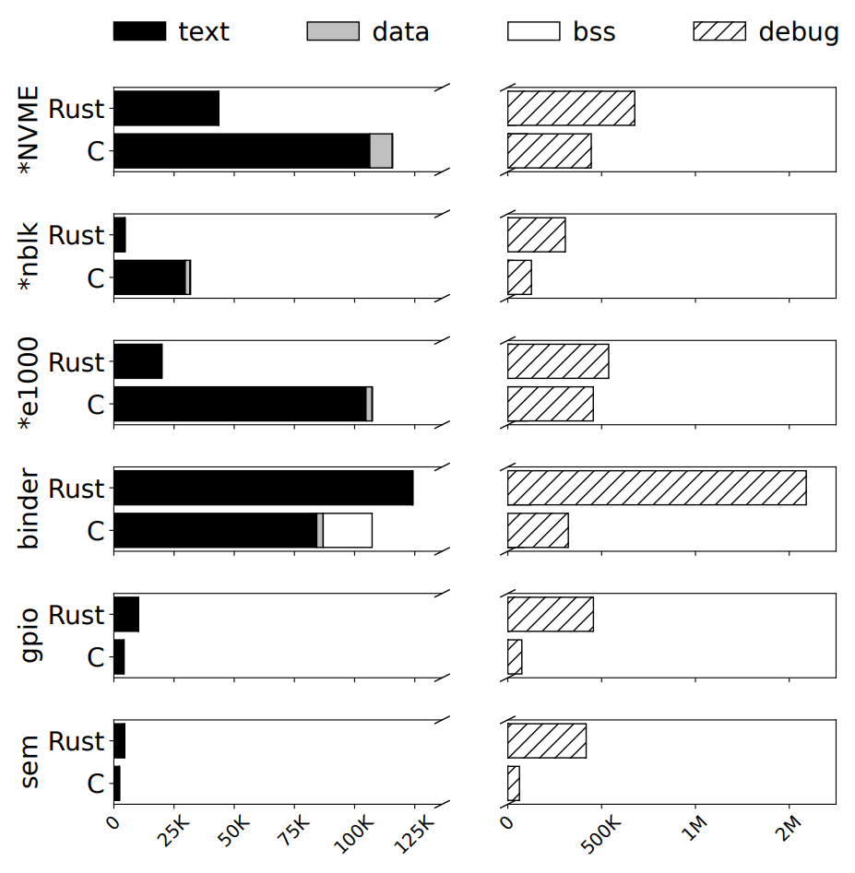
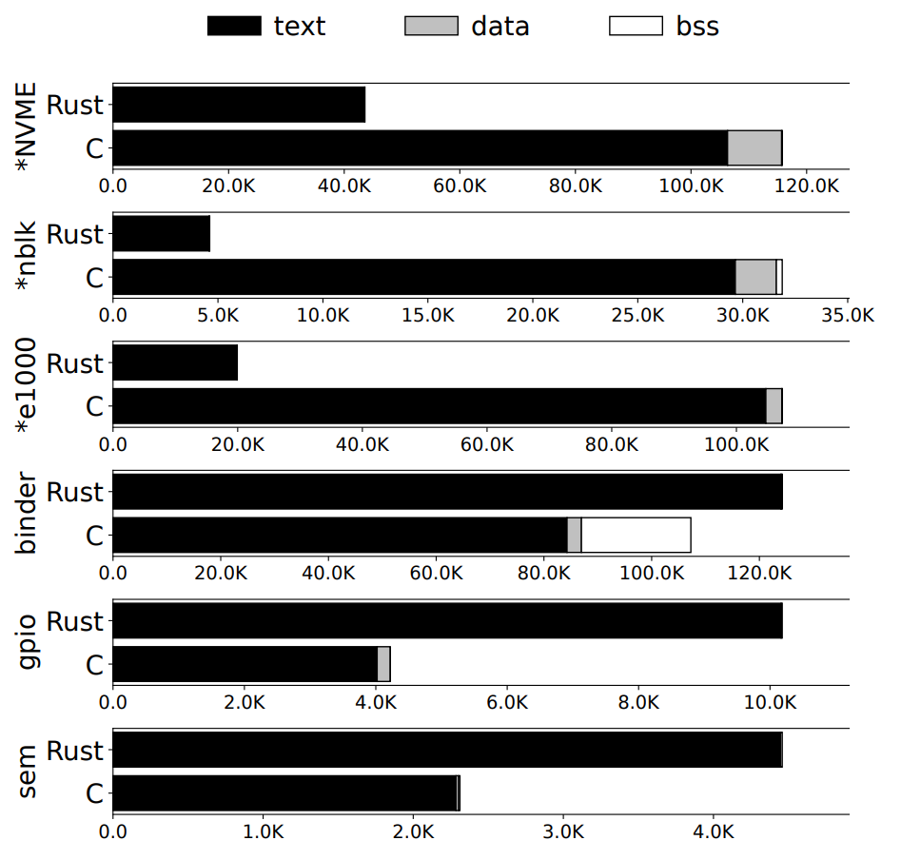
Q2: Does Rust bring additional overhead? (RQ2)
Setup
Binary size overhead
1.2× for binder, 2.4× for gpio, and 1.9× for sem (* means full feature in Rust)

Slide 25
Q2: Does Rust bring additional overhead? (RQ2)
Setup
Binary size overhead
1.2× for binder, 2.4× for gpio, and 1.9× for sem (* means full feature in Rust)
Rust brings overhead especially in the debug segmentation: 3.9×–6.6× larger

Slide 26
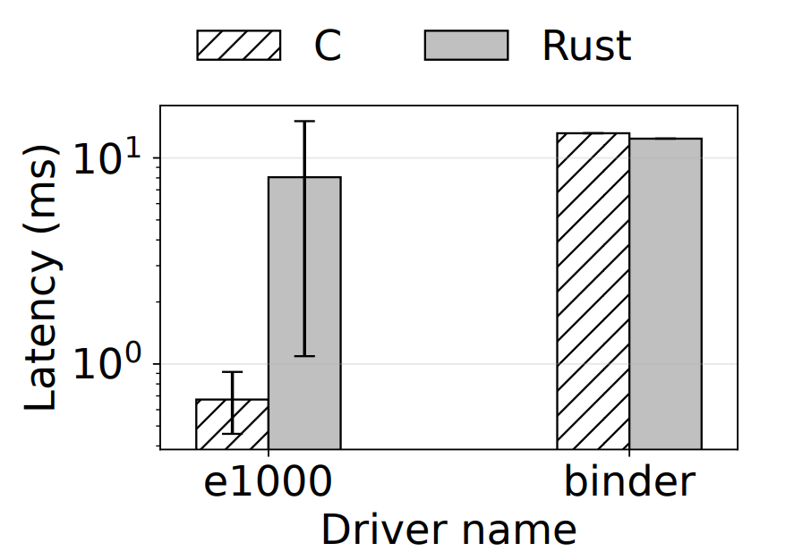
Q2: Does Rust bring additional overhead? (RQ2)
Setup
Binary size overhead
Runtime overhead
Latency
Rust e1000 driver lacks features, e.g., prefetch

Slide 27
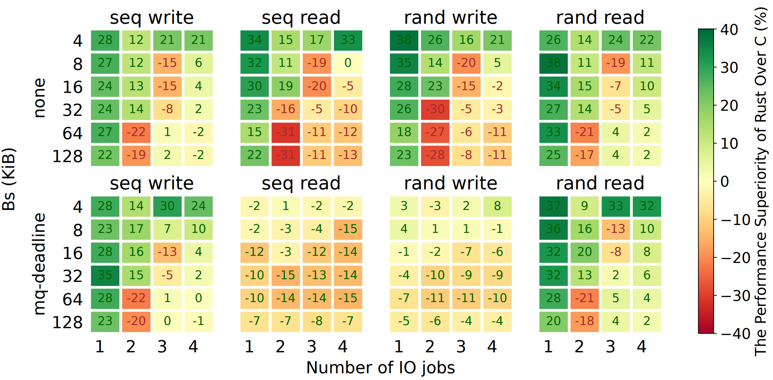
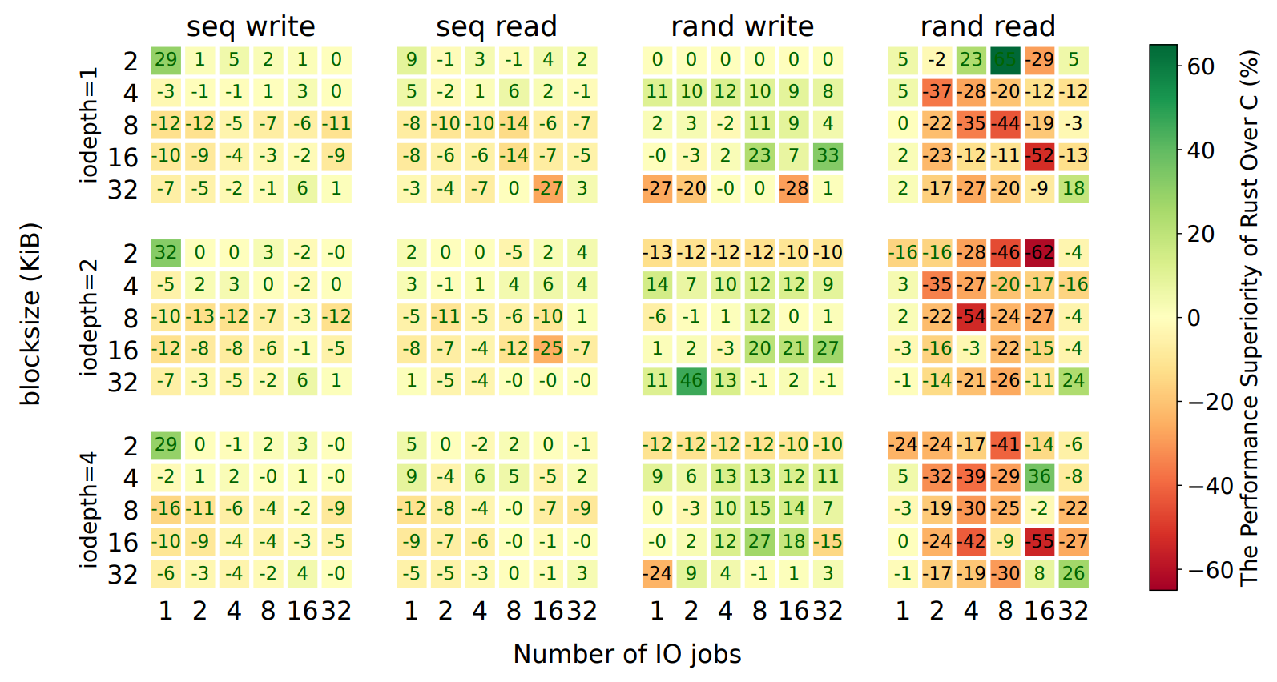
Q2: Does Rust bring additional overhead? (RQ2)
Setup
Binary size overhead
Runtime overhead
Latency
Throughput (poor)
Rust has higher cache miss rate due to smart pointer
Rust: 78,280,692 L1-icache-load-misses
2,240,713 dTLB-load-misses
C: 52,976,908 L1-icache-load-misses
1,312,452 dTLB-load-misses

Slide 28
Q2: Does Rust bring additional overhead? (RQ2)
Setup
Binary size overhead
Runtime overhead
Latency
Throughput (poor)
Rust has higher cache miss rate due to smart pointer
Rust runtime checks/bit field translation

Slide 29
Q2: Does Rust bring additional overhead? (RQ2)
Setup
Binary size overhead
Runtime overhead
Latency
Throughput (better)
Rust use less cache lines (pahole)
Less code path

Slide 30
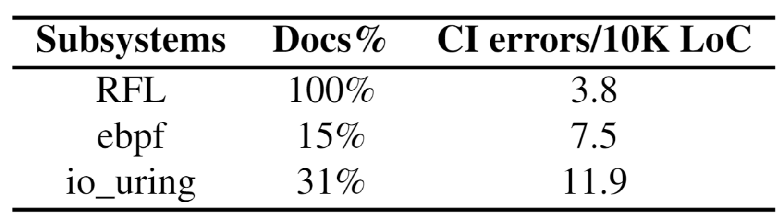
Q2: Does Rust bring additional overhead? (RQ2)
Improved code quality and readability
RFL improves the Linux documentation coverage by rustdoc
RFL has the built-in CI system which improves the code quality

Slide 31
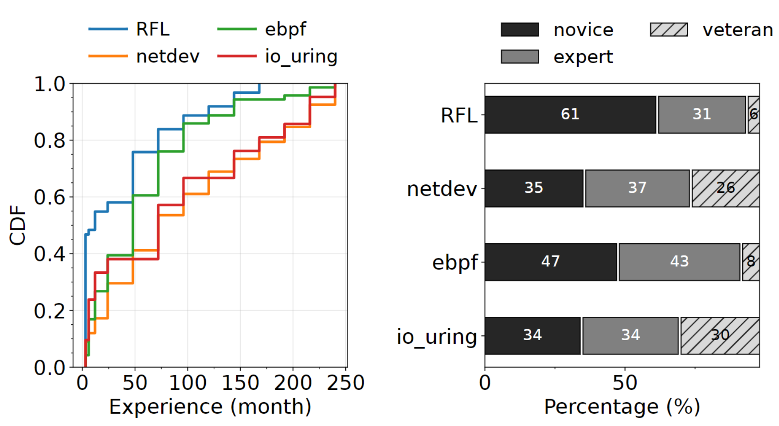
Q2: Does Rust bring additional overhead? (RQ2)
Improved code quality and readability
More young blood to the Linux community
RFL has the most novice developers
We observe 5 out 6 RFL drivers are developed by the non-novice

Slide 32
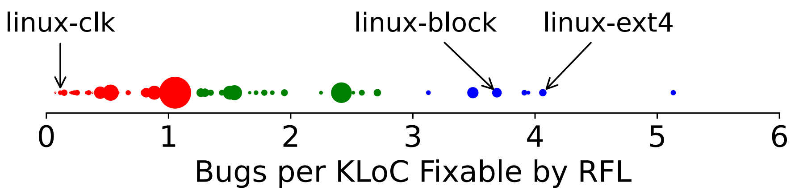
RQ3: what are the lessons learned from RFL?
For the developers using and building RFL
use Rustbelt/miri to evaluate the correctness of safety abstraction
write your program with ownership in mind
accept unsafe if you have to
For the developers expanding RFL scope
choose the subsystem/drivers that are more fragile

Slide 33
Takeaways
Memory safety with the price
No sliver bullet and no guarantee
Nearly zero-cost

Slide 34


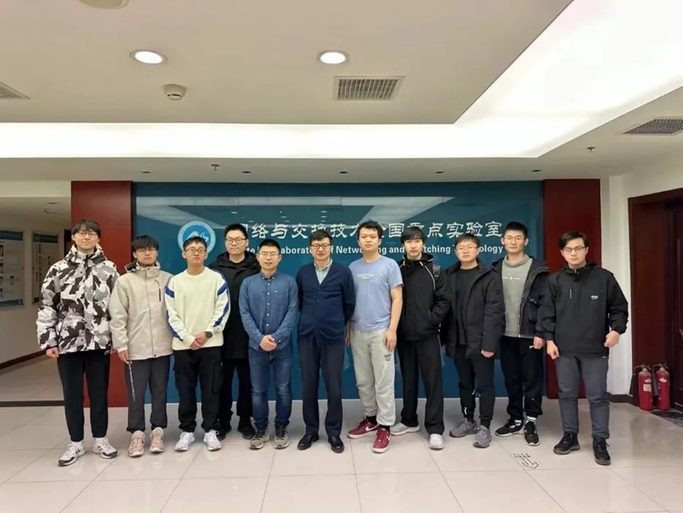
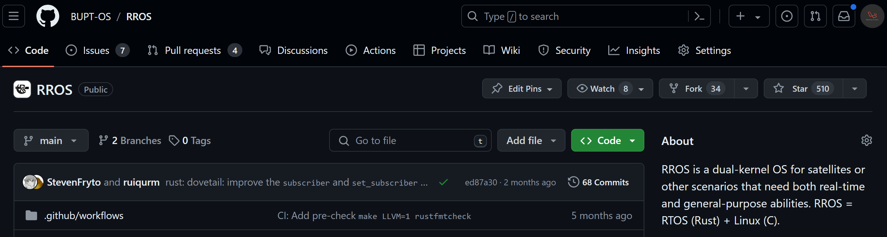





Shout out to the RROS team and my advisors!
RROS is a Rust dual kernel
Hongyu Li
Liwei Guo
Yangye Xuan
Shangguang wang
Mengwei Xu

Slide 35
Thanks Q&A
Source code: https://github.com/Richardhongyu/rfl_empirical_tools
RROS: https://github.com/BUPT-OS/RROS/
Email: lihongyu1999@bupt.edu.cn, lwg@uestc.edu.cn

